Slide 1
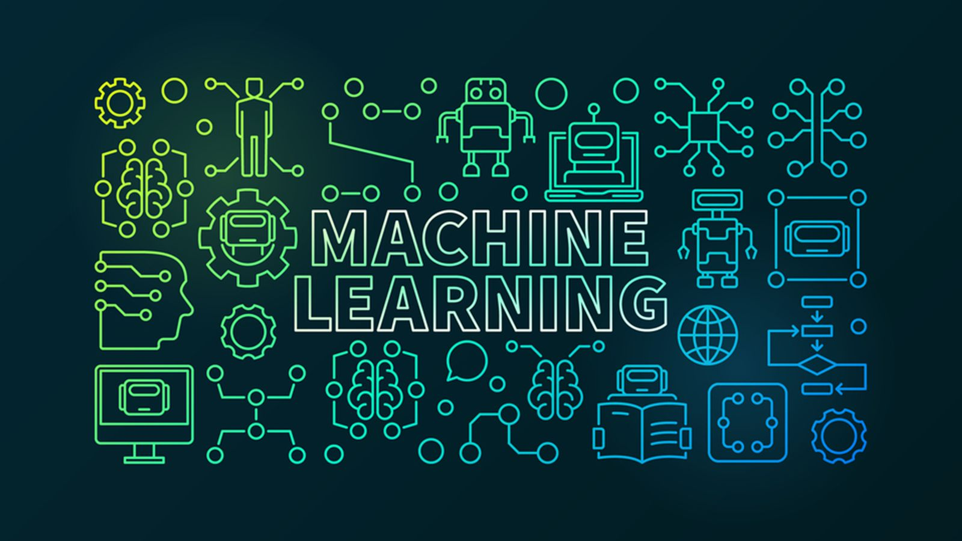

Slide 2
About me
Name: Pranav Ghatigar
Studying at Dayananda Sagar University
Computer Science and Engineering ’24

Slide 3
Content
Introduction to Machine learning
Supervised, unsupervised and Reinforcement Learning
Data warehouse and data mining
Implementation of the following Algorithms
Linear Regression
Logistic Regression
Decision Tree
Random Forest
KNN
SVM
Applications Of Machine Learning

Slide 4
What is Machine Learning
It is the study of computer algorithms that can improve automatically through experience and by the use of data.
Machine learning is a field of computer science that uses statistical techniques to give computer systems the ability to learn without explicit programming.

Slide 5
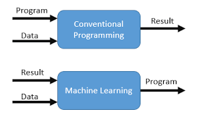
VS Traditional Programming

Slide 6
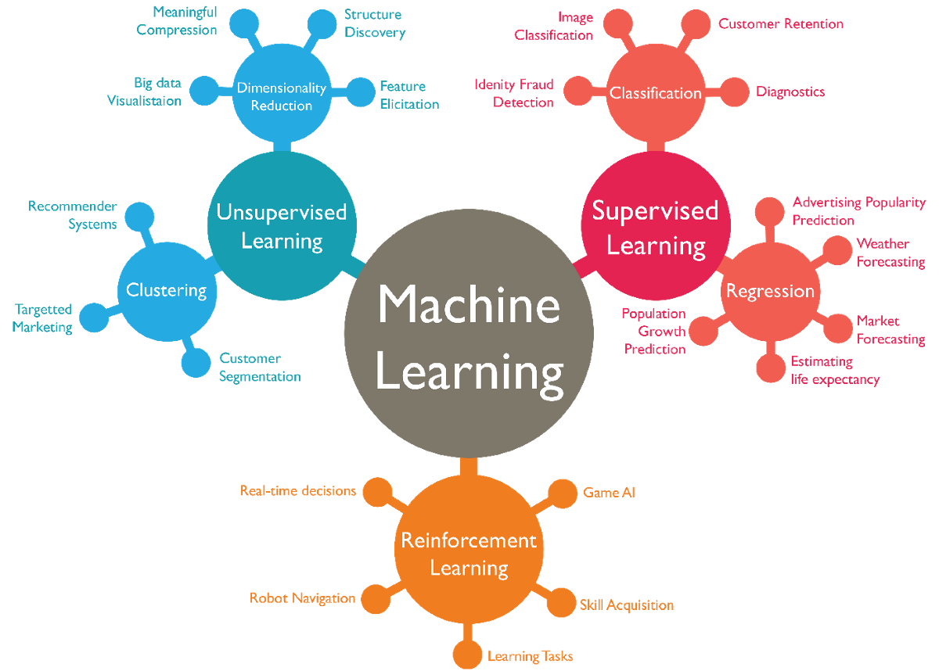
Types

Slide 7
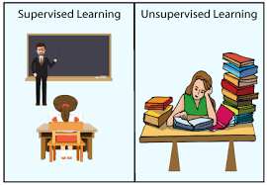

Slide 8
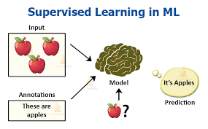

Slide 9
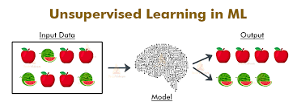

Slide 10
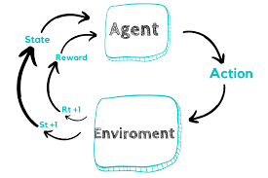
Reinforcement Learning

Slide 11
Definitions
Supervised Learning – A type of learning where features and labels are given to the ML algorithm and prediction takes place.
Unsupervised Learning – A type of learning where only features and given to the ML algorithm and prediction takes place.
Reinforcement Learning – A type of learning which is about taking the right actions in order to maximize cumulative reward.

Slide 12
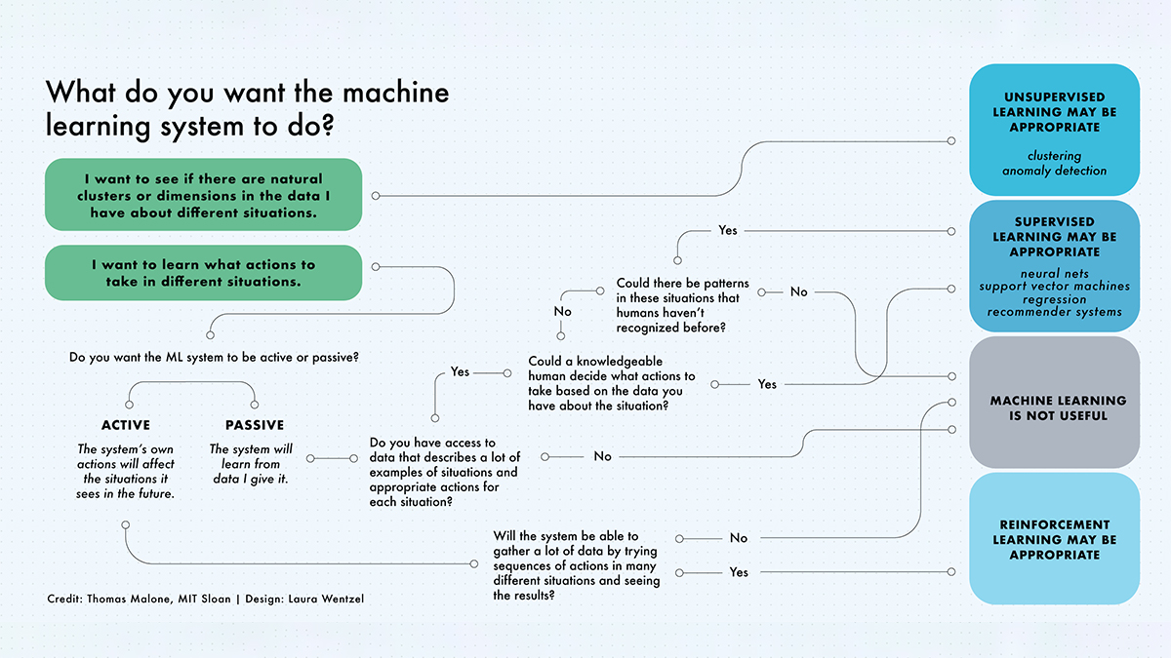

Slide 13
Data Warehouse
Data warehousing is the process of constructing and using a data warehouse.
A data warehouse is constructed by collecting data from multiple sources which can be used to
Analyse reports
Structured queries
Decision making

Slide 14
Data Mining
It is the process of extracting data from data warehouse to discover hidden patterns in large data set using methods such as machine learning, statistics and DBMS.
Some tools such as, Xplenty, IBM Cognos, Apache Kylin are used.

Slide 15
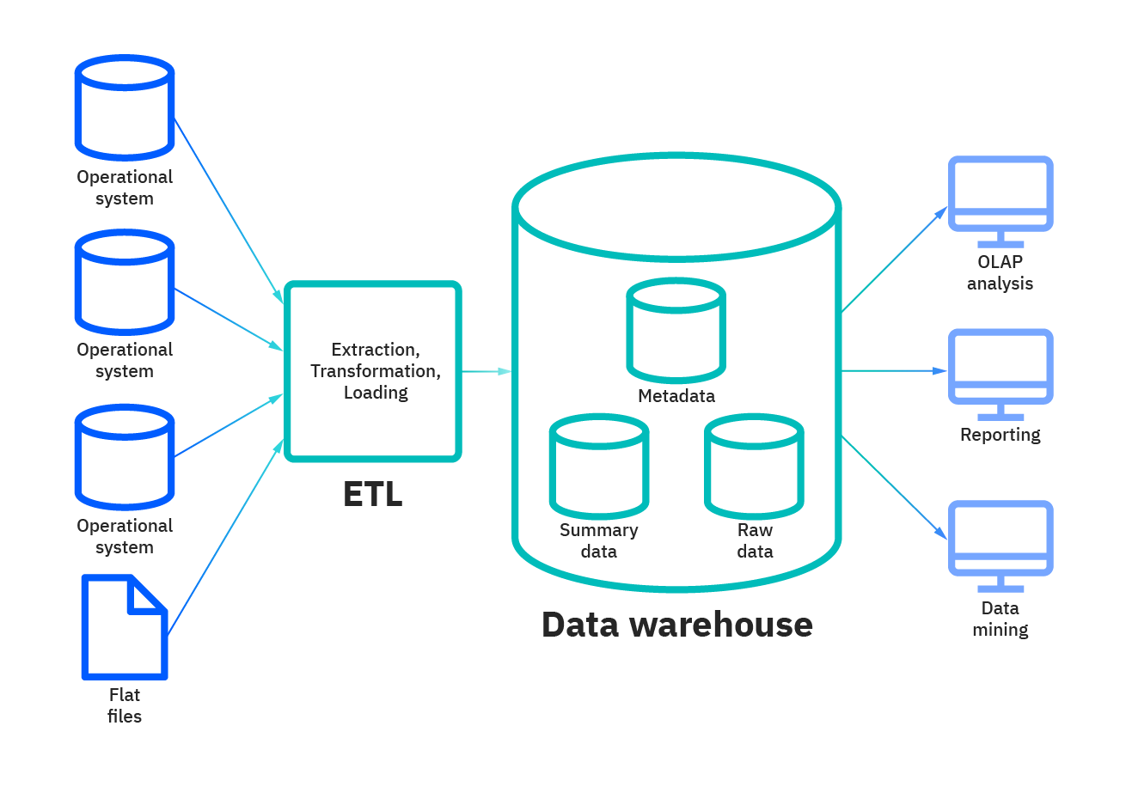

Slide 16
ML algorithms
Linear Regression
Logistic Regression
Decision Tree
Random Forest
KNN
SVM

Slide 17

Linear Regression
Used to predict the value of a variable based on the value of previous continuous data.
Sample code:
from sklearn import linear_model
x = [[4], [5], [6], [7], [8], [9]]
y = [12, 15, 18, 21, 24, 27]
classifier = linear_model.LinearRegression()
classifier.fit(x, y)
X_marks = [[13]]
print(classifier.predict(X_marks))

Slide 18

Logistic Regression
Logistic regression is a process of modeling the probability of a discrete outcome given an input variable.
That is pass or fail, true or false, cat or dog, etc.
Sample code:
from sklearn.linear_model import LogisticRegression
x = [[30], [40], [50], [60], [20], [10], [70]]
y = [0, 1, 1, 1, 0, 0, 1]
classifier = LogisticRegression()
classifier.fit(x,y)
X_marks = [[50]]
print(classifier.predict(X_marks))

Slide 19
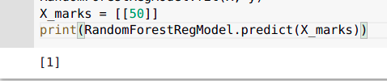
Decision tree
It has a tree like structure which builds the best attribute as root, then splits the dataset into subsets.
Usually used to predict class or value of target variable.
Sample code:
from sklearn.tree import DecisionTreeClassifier
X = [[30], [40], [50], [60], [20], [10], [70]]
y = [0, 1, 1, 1, 0, 0, 1]
RandomForestRegModel = DecisionTreeClassifier(criterion='entropy',random_state=0)
RandomForestRegModel.fit(X, y)
print(RandomForestRegModel.predict([50]))

Slide 20

Random Forest
It comes under supervised classification algorithm.
Multiple number of decision trees together forms a random forest. It uses the rule of each randomly created decision tree and stores the predicted outcome and the most voted prediction is the final.
Sample code:
from sklearn.ensemble import RandomForestRegressor
X = [[30], [40], [50], [60], [20], [10], [70]]
y = [0, 1, 1, 1, 0, 0, 1]
RandomForestRegModel= RandomForestRegressor()
RandomForestRegModel.fit(X, y)
X_marks = [[50]]
print(RandomForestRegModel.predict(X_marks))

Slide 21

KNN k-Nearest Neighbours
Used for classification and regression.
It simply compares the stored cases with the new data for majority of ‘k’- neighbours.
Sample code:
from sklearn.tree import DecisionTreeClassifier
from sklearn.neighbors import KNeighborsClassifier
X = [[30], [40], [50], [60], [20], [10], [70]]
y = [0, 1, 1, 1, 0, 0, 1]
classifier = KNeighborsClassifier(n_neighbors=5, metric='minkowski', p=2)
classifier.fit(X, y)
X_marks = [[50]]
print(classifier.predict(X_marks))

Slide 22
SVM
Stands for Support Vector Machine.
It ais a binary classifier. It differentiates the to closest given data-points.
Sample code:
from sklearn.svm import SVC
X = [[30], [40], [50], [60], [20], [10], [70]]
y = [0, 1, 1, 1, 0, 0, 1]
classifier = SVC(kernel='linear', random_state=0)
classifier.fit(X, y)
X_marks = [[55]]
print(classifier.predict(X_marks))

Slide 23
But why?
Machine learning is important because of its wide range of applications and its incredible ability to adapt and provide solutions to complex problems efficiently, effectively and quickly.
It can increase the value of your embedded analytics in many areas, such as natural language interfaces, automatic outlier detection, recommendation system and many more.
All of these features help speed user insights and reduce decision bias.

Slide 24
Applications of ML
They are used from day-to-day life
Speech Recognition:
Virtual Assistant – Siri, Alexa
Text-to-speech and vice versa
Computer Vision:
Face Detection
Hand Writing and fingerprint
Business Intelligence
Customer Support
Product Recommendation
Business Analytics

Slide 25
Applications of ML
Banking:
Fraud Monitoring
Data Security
Financial Trading
Health Care:
Disease Identification and Diagnosis
Robotic Surgery
Wearable Tech

